Slide 1

Collection and Map

Slide 2
Agenda
Collection and its types
List - LinkedList,
ArrayList
Set - Hashset,
LinkedHashSet,
Treeset
Map - HashMap, LinkedHashMap, TreeMap
Generic and Non-Generic Collections,

Slide 3
DB
Application
CLIENT
Collections Framework
passenger1
passenger2
passenger3

Slide 4
java.util.Collection
List
Set
Queue
ArrayList
LinkedList
HashSet
SortedSet
PriorityQueue
Vector
LinkedHashSet
TreeSet

Slide 5
Map
123 | order5
478 | order7
989 | order1
HashMap
SortedMap
LinkedHashMap
TreeMap
Hashtable

Slide 6
Collections in Java
The Collection in Java is a framework that provides an architecture to store and manipulate the group of objects.
Java Collections can achieve all the operations that you perform on a data such as searching, sorting, insertion, manipulation, and deletion.
Java Collection means a single unit of objects. Java Collection framework provides many interfaces (Set, List, Queue, Deque) and classes (ArrayList, Vector, LinkedList, PriorityQueue, HashSet, LinkedHashSet, TreeSet).
A Collection represents a single unit of objects, i.e., a group.

Slide 7
What is a framework in Java
It provides readymade architecture.
It represents a set of classes and interfaces.
It is optional.
Collection framework
The Collection framework represents a unified architecture for storing and manipulating a group of objects. It has:
Interfaces and its implementations, i.e., classes
Algorithm

Slide 8
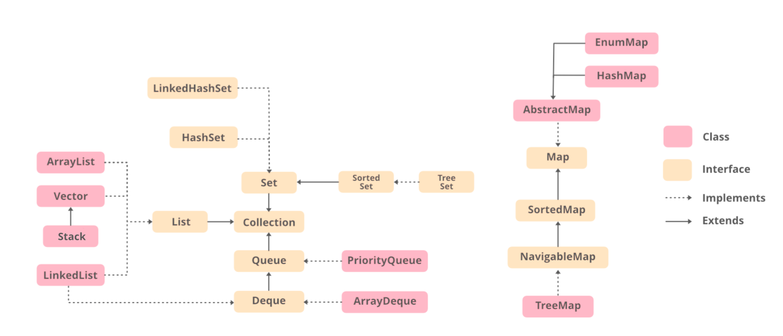
Hierarchy of Collection Framework

Slide 9
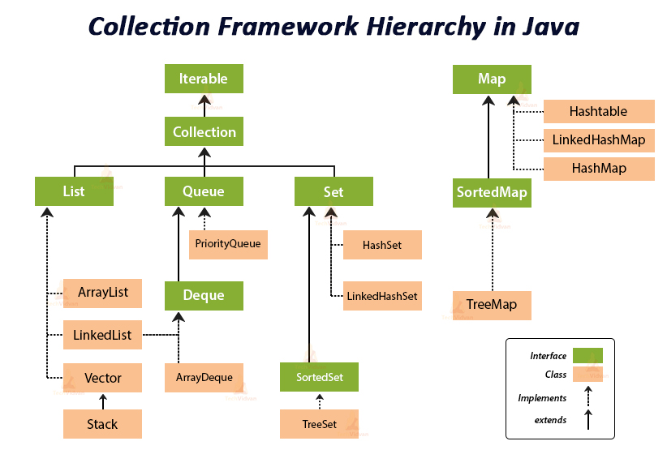

Slide 10
Collection Interface
The Collection interface (java.util.Collection) and Map interface (java.util.Map) are the two main “root” interfaces of Java collection classes.
The Collection interface is the interface which is implemented by all the classes in the collection framework. It declares the methods that every collection will have.
In other words, we can say that the Collection interface builds the foundation on which the collection framework depends.

Slide 11
Advantages of the Collection Framework
Consistent API: The API has a basic set of interfaces like Collection, Set, List, or Map, all the classes (ArrayList, LinkedList, Vector, etc) that implement these interfaces have some common set of methods.
Reduces programming effort: A programmer doesn’t have to worry about the design of the Collection but rather he can focus on its best use in his program. Therefore, the basic concept of Object-oriented programming (i.e.) abstraction has been successfully implemented.
Increases program speed and quality: Increases performance by providing high-performance implementations of useful data structures and algorithms because in this case, the programmer need not think of the best implementation of a specific data structure. He can simply use the best implementation to drastically boost the performance of his algorithm/program.

Slide 12
Generic Collection
Errors appear at compile time than at run time.
Code reusability: Generics help in reusing the code already written, thereby making it usable for other types (for a method, or class, or an interface).
If a data structure is generic, say a list, it would only take specific type of objects and return the same specific type of object as output. This eliminates the need to typecast individually.
Algorithms can be implemented with ease, since they can be used to work with different types of objects, and maintaining type safety as well as code reusability.

Slide 13
ArrayList
Fast Access
obj1 | obj2 | obj3 | obj4 | obj5 | obj6
10
0
1
2
3
4
5
obj1 | obj2 | obj3 | obj4 | obj5 | obj6
ArrayList(100);
read
vs
insert and delete

Slide 14
Java ArrayList
Java ArrayList class uses a dynamic array for storing the elements. It is like an array, but there is no size limit. We can add or remove elements anytime. So, it is much more flexible than the traditional array.
The ArrayList in Java can have the duplicate elements also. It implements the List interface so we can use all the methods of List interface here. The ArrayList maintains the insertion order internally.
It inherits the AbstractList class and implements List interface.

Slide 15
The important points about Java ArrayList class are:
Java ArrayList class can contain duplicate elements.
Java ArrayList class maintains insertion order.
Java ArrayList class is non synchronized.
Java ArrayList allows random access because array works at the index basis.
In ArrayList, manipulation is little bit slower than the LinkedList in Java because a lot of shifting needs to occur if any element is removed from the array list.

Slide 16
How to create an ArrayList?
ArrayList<String> alist=new ArrayList<String>();
Similarly we can create ArrayList that accepts int elements.
ArrayList<Integer> list=new ArrayList<Integer>();

Slide 17

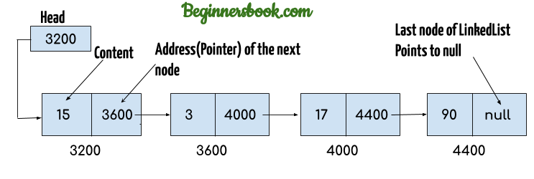
LinkedList representation
Each element in the LinkedList is called the Node. Each Node of the LinkedList contains two items: 1) Content of the element 2) Pointer/Address/Reference to the Next Node in the LinkedList.

Slide 18
1. Head of the LinkedList only contains the Address of the First element of the List.
2. The Last element of the LinkedList contains null in the pointer part of the node because it is the end of the List so it doesn’t point to anything as shown in the above diagram.
3. The diagram which is shown above represents a singly linked list.
There is another complex type variation of LinkedList which is called doubly linked list, node of a doubly linked list contains three parts: 1) Pointer to the previous node of the linked list 2) content of the element 3) pointer to the next node of the linked list.

Slide 19
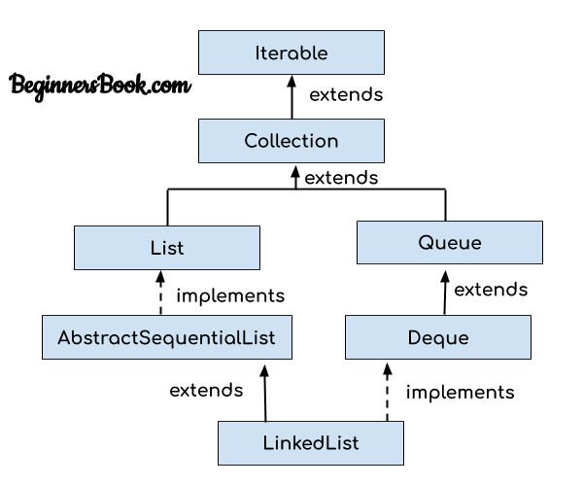

Slide 20
HashSet Class in Java
This class implements the Set interface, backed by a hash table (actually a HashMap instance).
It makes no guarantees as to the iteration order of the set; in particular, it does not guarantee that the order will remain constant over time. This class permits the null element.

Slide 21
HashSet doesn’t maintain any order, the elements would be returned in any random order.
HashSet doesn’t allow duplicates. If you try to add a duplicate element in HashSet, the old value would be overwritten.
HashSet allows null values however if you insert more than one nulls it would still return only one null value.
HashSet is non-synchronized.
The iterator returned by this class is fail-fast which means iterator would throw ConcurrentModificationException if HashSet has been modified after creation of iterator, by any means except iterator’s own remove method.

Slide 22
HashSet Methods
boolean add(Element e): It adds the element e to the list.
void clear(): It removes all the elements from the list.
Object clone(): This method returns a shallow copy of the HashSet.
boolean contains(Object o): It checks whether the specified Object o is present in the list or not. If the object has been found it returns true else false.
boolean isEmpty(): Returns true if there is no element present in the Set.
int size(): It gives the number of elements of a Set.
boolean(Object o): It removes the specified Object o from the Set.

Slide 23
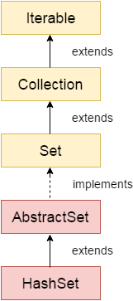

Slide 24
LinkedHashSet Class
LinkedHashSet is also an implementation of Set interface, it is similar to the HashSet and TreeSet except the below mentioned differences:
HashSet doesn’t maintain any kind of order of its elements.
TreeSet sorts the elements in ascending order.
LinkedHashSet maintains the insertion order. Elements gets sorted in the same sequence in which they have been added to the Set.

Slide 25
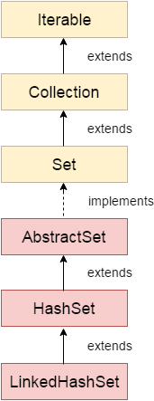

Slide 26
Java TreeSet class
Java TreeSet class implements the Set interface that uses a tree for storage. It inherits AbstractSet class and implements the NavigableSet interface. The objects of the TreeSet class are stored in ascending order.
The important points about Java TreeSet class are:
Java TreeSet class contains unique elements only like HashSet.
Java TreeSet class access and retrieval times are quiet fast.
Java TreeSet class doesn't allow null element.
Java TreeSet class is non synchronized.
Java TreeSet class maintains ascending order.

Slide 27
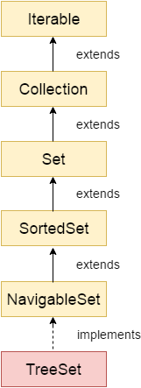

Slide 28
Java Map Interface
HashMap doesn’t maintain any order.
TreeMap sort the entries in ascending order of keys.
LinkedHashMap maintains the insertion order.
A map contains values on the basis of key, i.e. key and value pair. Each key and value pair is known as an entry. A Map contains unique keys.
A Map is useful if you have to search, update or delete elements on the basis of a key.
HashMap doesn’t maintain any order.
TreeMap sort the entries in ascending order of keys.
LinkedHashMap maintains the insertion order.

Slide 29
Java Map Hierarchy

Slide 30
HashMap in Java
HashMap is a Map based collection class that is used for storing Key & value pairs, it is denoted as HashMap<Key, Value> or HashMap<K, V>.
This class makes no guarantees as to the order of the map. It is similar to the Hashtable class except that it is unsynchronized and permits nulls(null values and null key).
It is not an ordered collection which means it does not return the keys and values in the same order in which they have been inserted into the HashMap. It does not sort the stored keys and Values.
You must need to import java.util.HashMap or its super class in order to use the HashMap class and methods.

Slide 31
LinkedHashMap
LinkedHashMap is a Hash table and linked list implementation of the Map interface, with predictable iteration order.
This implementation differs from HashMap in that it maintains a doubly-linked list running through all of its entries.
This linked list defines the iteration ordering, which is normally the order in which keys were inserted into the map (insertion-order).
HashMap doesn’t maintain any order.
TreeMap sort the entries in ascending order of keys.
LinkedHashMap maintains the insertion order.

Slide 32
TreeMap in Java
TreeMap is Red-Black tree based NavigableMap implementation. It is sorted according to the natural ordering of its keys.
TreeMap class implements Map interface similar to HashMap class.
The main difference between them is that HashMap is an unordered collection while TreeMap is sorted in the ascending order of its keys.
TreeMap is unsynchronized collection class which means it is not suitable for thread-safe operations until unless synchronized explicitly.

Slide 33
Generic Collection
Errors appear at compile time than at run time.
Code reusability: Generics help in reusing the code already written, thereby making it usable for other types (for a method, or class, or an interface).
If a data structure is generic, say a list, it would only take specific type of objects and return the same specific type of object as output. This eliminates the need to typecast individually.
Algorithms can be implemented with ease, since they can be used to work with different types of objects, and maintaining type safety as well as code reusability.

Slide 34
Non - Generic Collection
When the data structure is non-generic, it causes issues when the data is tried to be retrieved from the collection/data structure.
Every time an element from the collection is retrieved, it needs to be explicitly type-casted to its required type, which is a problem when there are too many elements.

Slide 36
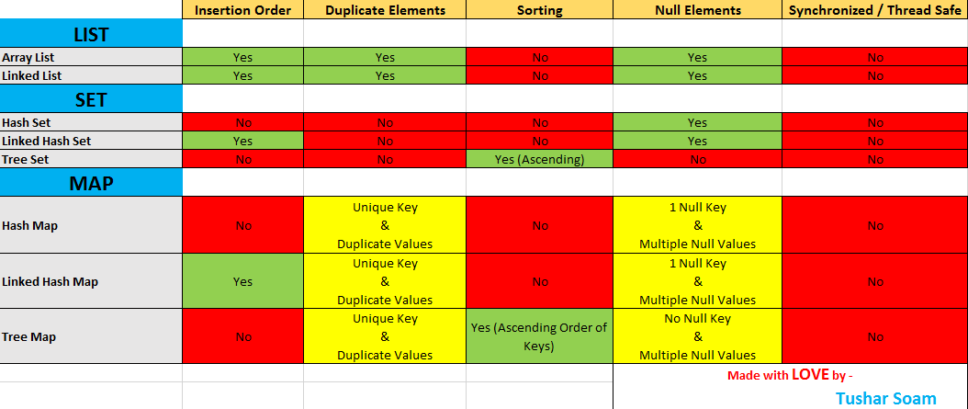

Slide 37


